Slide 1



Linux Day 2
Services, Backdoors, and How to Protect

Slide 2
Processes and Services

Slide 3
- Processes
runs background or foreground on system
occurs as a result of a
command/script being run
has a PID (process ID)
Services
background
consists of 1+ processes
serves the user some sort of function
ssh, ftp, samba, etc.
Daemons
Background
non-terminal
Definitions

Slide 4
Processes Specified
- ps -aux | less
- -a: info about all users
-u: additional information
- -f: full information
-x: shows info about
processes w/o terminals
- kill -9 [PID]
- kills the speciﬁed process completely (force quits the process)

Slide 5
Relevance of Processes
Processes- don’t give you points necessarily in CyPat but they can lead you to discover more vulnerabilities happening on the system
useful in real-life situations because you can see what is happening on the background

Slide 6
- service --status-all
Services Specifically
checks all running services and their current settings
[+] = active
[?] = masked
- [-] = off
Other helpful commands:
sudo [service_name] restart
sudo [service_name] stop
sudo [service_name] status

Slide 7
Service Hunting
in CyberPatriot you should also ﬁnd services that are malicious or are not speciﬁed in the README (for instance if they ask you to host openssh only then you can delete apache2 and stuff)
don’t delete critical services and everything should be all good :)

Slide 8
Backdoors

Slide 9




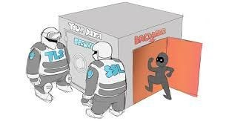



Backdoors
sneaky bois

Slide 10
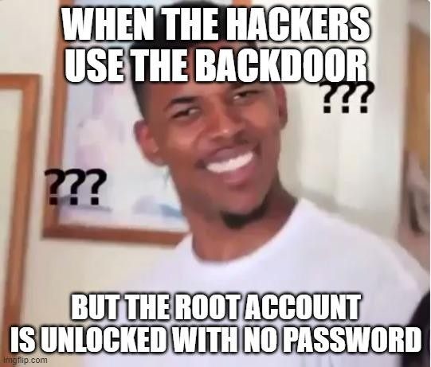

How to prevent backdoors?
Just let them use the front door (duh)

Slide 11

What are backdoors?
Backdoors: a point of access where users (authorized or not) gain access to root privileges on a system, usually to exploit it
can be used for good/bad stuff (either companies or hackers use)
many instances are opened by bad peeps
THEY MUST STAY IN (persistence is key)

Slide 12
- bind shell: the attacker targets the user (victim) by listening on an open port and connecting to it (their shell)
Types of Backdoors
THEY connect to YOU
inbound trafﬁc
reverse shell: the attacker opens up a listener port while the user connects to said port (access to the shell)
YOU connect to THEM
outbound trafﬁc
- insecure remote services: pretty much just hackers exploiting services (SSH, Samba, Telnet) to connect onto device
12

Slide 13
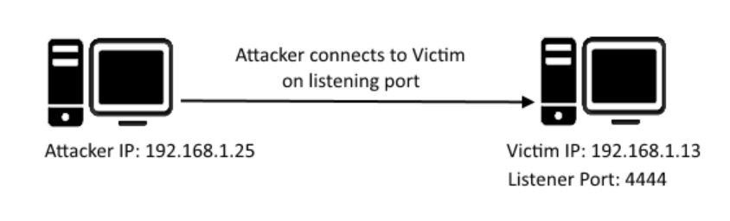
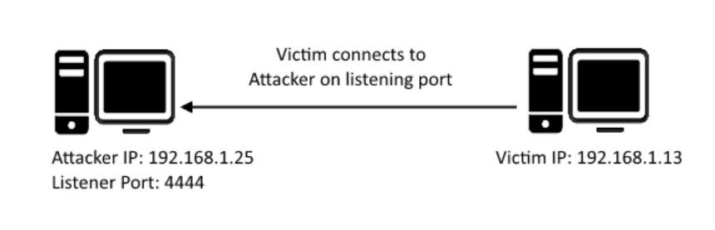

QUIZ
bind shell/shell bind
reverse shell

Slide 14
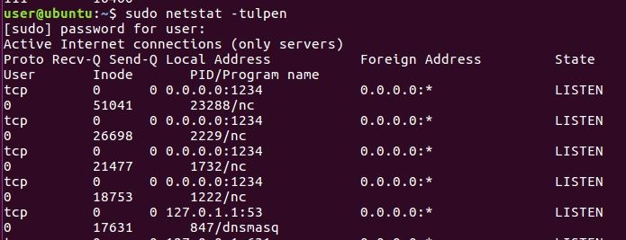
How to Actually Remove/Detect Backdoors
netstat
prints network connections, routing tables, bunch of other stuff
netstat -tulpn: displays a bunch of information about port connections and processes
-t = tcp
-u = udp
-l = listening ports
-p = port
-n = numerical address
14

Slide 15
How to Actually Remove/Detect Backdoors, Part 2
Track down the processes that are using the ports using lsof or fuser or ps aux
lsof- checks all open ﬁles and the processes that are running them
fuser- displays PIDs of processes using the ﬁles
remember ps -aux?
kill said processes after (kill -9
<pid>) and delete ﬁles attached to them
15

Slide 16

Crontabs
located in /etc/crontab and /var/spool
- task schedulers that schedule events to happen at a certain time/moment
* = stands for “every”
- ***** [backdoor]
- each place stands for a time (every minute of every hour of every day of every month of every year, forever)

Slide 17

System Crontabs vs. User Crontabs
System Crontabs:
/etc/crontab
/etc/cron.d/
/etc/cron.daily
/etc/cron.monthly
/etc/cron.weekly
/etc/cron.hourly
User Crontabs:
must be root (command?!?)
check the /var/spool/cron directory
empty = good

Slide 18

rc.local
/etc/rc.local
script that is run after other system services are running
Linux formerly ran on runlevels to determine the state of the system but has been deprecated
check to make sure it is empty so that nothing else is running besides what should be there (exit 0)

Slide 19
- Firewalls are important in ﬁltering network trafﬁc
UFW
(Uncomplicated Firewall)
- You want to block things that harm your computer from coming in.
UFW is the tool to do that.
- There is also gufw, which uses the GUI, and that appears in your system settings for conﬁguration. But it’s better to use ufw.
TO PREPARE:
sudo apt-get install ufw
More commands on the next slide.
19

Slide 20
ufw enable
Enables ﬁrewall and enables ﬁrewall on boot
ufw disable
Disable ﬁrewall and disable ﬁrewall on boot
ufw default allow|deny|reject [incoming|outgoing|routed]
Sets the default for all incoming,
outgoing, or routed packets (depending on option) to allow, deny, or reject (depending on the option)
UFW commands
20

Slide 21
ufw reject [args]
Reject any packet following these arguments (We will go over args in next slide)
ufw allow [args]
Allow any packet following these arguments (We will go over args in next slide)
ufw deny [args]
Deny any packet following these arguments (We will go over args in next slide)
ufw logging [on|off]
Enables logging,
logs can be found at
/var/log/ufw.log
UFW
commands, continued
21

Slide 22
Example arguments
24/tcp
This is a port number and a protocol
sshd
A service name
apache2/udp
A service name and a protocol
Deny means do not allow that package to travel in the speciﬁed direction (incoming,outcoming). Default direction is incoming
Reject means do not allow that package to travel in speciﬁed direction and inform the sender that the packet was rejected
Allow means do allow that
packet to travel.
22
Arguments in UFW commands

Slide 23

Important commands to use
sudo ufw enable
sudo ufw reset
sudo ufw default deny incoming
sudo ufw default allow outgoing
sudo ufw allow [service you need, like ssh]

Slide 24
Important Configurations We Will Be Going Over
SSH
FTP
Samba

Slide 25
SSH
SSH: Secure Shell
- Provides remote terminal connection to other people
Conﬁg ﬁle: /etc/ssh/sshd_conﬁg

Slide 26
- Protocol 2
PermitEmptyPasswords no
Why would we disable this?
PermitRootLogin no
Why would we disable root login?
PasswordAuthentication no
Yes, I said no. Does
Important SSH Settings
anyone know why?
RSAAuthentication yes
PubkeyAuthentication yes
X11Forwarding no
26

Slide 27

When you are done configuring...
sudo service sshd restart

Slide 28

FTP
File Transfer Protocol
Allows you to move ﬁles between computers
FTP is not secure
Look up when it was created, and tell me why it isn’t.
To meet these vulnerabilities, vsftpd (very secure ftp daemon) and PureFTPD were created

Slide 29
- Some servers are built so anyone can use them
- Mozilla.ﬁrefox.org is an example
Some are built for private usage
- Companies have ﬁles on their servers that are only meant for employees
You can access anonymous servers by providing your username and password as anonymous
You have to access
non-anonymous servers as a local user
Anonymous vs.
Non-Anonymous Servers
29

Slide 30

Some Basic Steps Before We Configure
Install the required FTP software
sudo apt install vsftpd
sudo apt install pure-ftpd
Allow FTP through the ﬁrewall
sudo ufw allow ftp
Create the appropriate local users

Slide 31
- Open /etc/vsftpd.conf
anonymous_enable=NO
Given what you know about anonymous and non-anonymous, why is this setting important?
chroot_local_user=YES
We’ll go into chroot on the next slide
local_enable=YES
write_enable=YES
sudo service vsftpd restart
Vsftpd configuration
31

Slide 32
- Go to ftp.mozilla.org
- It says “Index of /”
- Why would they give us access to the / directory? That seems insecure.
More About Chroot
- This is a chroot jail
- Chroot stands for change root
You make the folder the user can access appear to be the root directory, even if it’s not
The users are then conﬁned to that folder, because root is the highest directory, and you can’t go out of it
You want users on an FTP server to only access the appropriate ﬁles, so a chroot directory stops them from accessing everything
on the server
32

Slide 33
- vsftpd is more secure, but CyberPatriot might require this
It is harder to conﬁgure, because there isn’t one ﬁle. It’s a whole bunch, each with its own conﬁguration.
TLS: degree of SSL enforcement
(0-2)
NoAnonymous: force private
AnonymousOnly: force public
UnixAuthentication: unencrypted authentication
PamAuthentication: use PAM,
uses /etc/pam.d/pure-ftpd
ChrootEveryone: chroot everyone to their homes
Pure-ftpd configuration
systemctl restart pure-ftpd
33

Slide 34
- Unix apps that provide secure, stable ﬁle and print services
- Mostly for ﬁle sharing
Follows SMB protocol (Server Message Block)
Useful for sharing between
Windows and Linux
Runs on port 445
Samba
Doing Samba:
Install it
Make a share folder on the server.
Conﬁgure /etc/samba/smb.conf
Setup user accounts w/ passwords
Access it
34

Slide 35

Steps 1 and 2
sudo apt-get install samba
cd /mnt
mkdir sambashare
Add ﬁles in there
You have now installed samba and set up the directory on the server.

Slide 36
- Go to /etc/samba/smb.conf
Basics of
/etc/samba/smb.conf
It has a lot of parts: homes, printers, global, shares, personalized share conﬁgs
[global] conﬁgures behavior of server in general
[printers] is for the behavior of printers
[shares] conﬁgures ﬁle shares
[homes] and personalized shares are the same as [shares], but more speciﬁc.
36

Slide 37
- 3 types of shares:
Basics, continued
Global: what happens when others access you
Private: not accessible unless you have been given access
Public: shares that people can speciﬁcally request.
Public shares usually make the most sense.
37

Slide 38
- At the end of the ﬁle, add a section for sambashare using [sambashare]
Adding sambashare to the file
Add the following lines
comment = Samba on Ubuntu
path = /mnt/sambashare
read only = no
browseable = yes
Now restart the smdb service
38

Slide 39

Testing It
To test if smb.conf has errors, use the command testparm
- If it returns nothing, you’re good! It works.

Slide 40

Connecting to a Share
Add a user for samba
sudo adduser sambauser
Make sure to give a password
Add the user to samba
sudo smbpasswd -a sambauser
-a means add the user
-x removes the user

Slide 41
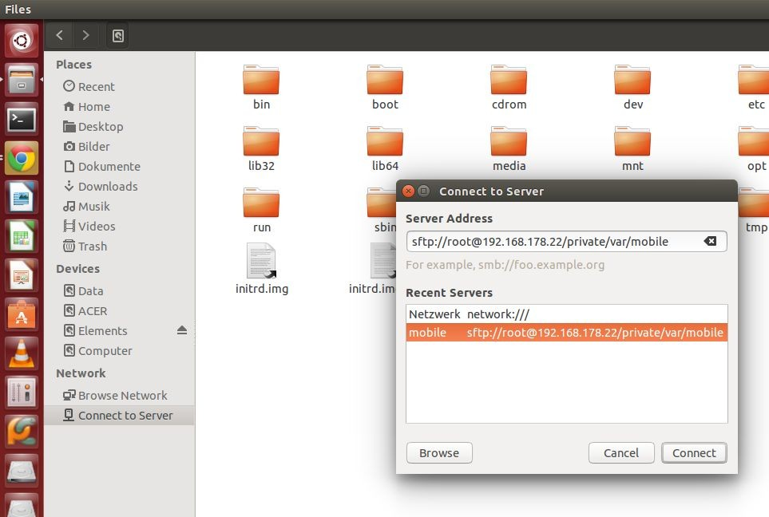
- Use the ifconﬁg command to look for your IP Address
How to Connect
- It should say 127.0.0.1
Cool. That’s done. Now:
Run the command nautilus (ﬁle explorer)
Click on connect the server, in the bar on the left
In the “Server Address” bar put smb://sambauser@127.0.0.1/sambashare
Put in your password, and now you can connect and share ﬁles!
41

Slide 42

Other Samba Configs
write ok - editable ﬁles/directory (writeable) read only - can only read ﬁles
valid users - list of users ok to login (or a @group)
guest ok - login password not needed (public vs private share)
browseable - can explore other directories in share
copy/template - copy conﬁgs from a template share

Slide 43

Things to look out for in Samba
Watch out for things that seem suspicious. For example:
[sharing] path = /
Now anyone on the share can view anything on your system. That’s bad.

Slide 44
1. Look at the shares and make sure to watch out for anything suspicious.
Tips for Samba
Delete unnecessary shares.
Be careful on what is commented. In Samba, both semicolons and # signs start comments.
44

